Slide 1
Vehicle Loan Default Prediction
By Abhinav Botla - 801290454
Ajith Gannamaneni - 801305442
Hrushikesh Dandge - 801317666
Mitra Buggaveeti -801310349
Prateek Chandra - 801311773

Slide 2
Table of contents
Introduction
Project scope
Data Source
Choice of data
Challenges of Dataset
Domain-specific Challenges
Data cleaning
Data Analysis
Visualization
AWS pipeline chart
Optimization and cost analysis
Conclusion

Slide 3
Introduction
https://github.com/mitrabuggaveeti/Cloudcomputing_Team_4?tab=readme-ov-file
This project addresses a concern in the financial sector—predicting the likelihood of loan default for vehicle loans in the initial Equated Monthly Installments (EMI) on the due date. Faced with significant losses due to defaults, the financial institution seeks to optimize its loan approval process through the implementation of a sophisticated machine learning credit risk scoring model. Leveraging diverse datasets encompassing loanee information, loan details, and bureau data, the model aims to identify key determinants influencing the probability of default. Aligned with the AWS Academy Cloud Foundations and Data Engineering program, the project integrates data engineering, machine learning, and cloud computing, contributing to data-driven decision-making. Anticipated outcomes include a substantial reduction in default rates, empowering the institution to proactively manage risk factors and refine underwriting criteria.

Slide 4
Project Scope
The financial institution is experiencing high losses due to borrowers defaulting on vehicle loans, especially on the first EMI. To counter this, the organization plans to use machine learning to create a credit risk scoring model. This model will specifically focus on predicting the likelihood of a borrower defaulting on their first EMI payment. This proactive approach aims to improve loan approval processes and reduce default rates.
The machine learning model will analyze data from multiple sources, including loanee demographics, loan details like the amount and asset cost, and comprehensive bureau data such as credit scores and loan history. This approach will allow the model to identify key factors that influence the probability of loan default. The integration of diverse data sets aims to enhance the accuracy of predicting defaults on vehicle loans.

Slide 5
Data Sources:
Credit Bureau Data: Credit bureaus are primary data sources for assessing an individual's creditworthiness. These bureaus collect and maintain credit-related information on individuals, such as credit scores, outstanding debts, and payment history. Access to such data can be crucial for building a credit risk scoring model. Many financial institutions subscribe to credit bureaus' services to obtain this data.
Loan Application Data: Financial institutions maintain records of loan applications, including applicant information, loan details, and application outcomes. This data source can be valuable in understanding loan approval and default patterns.
Public Datasets: As in the case of the Kaggle dataset you mentioned, there are often public datasets available that contain anonymized loan application and default data. These datasets can be useful for model development and research.

Slide 6
Choice of Data
We have taken data for this project from the kaggle https://www.kaggle.com/datasets/mamtadhaker/lt-vehicle-loan-default-prediction.
This dataset was chosen for its comprehensive information on loan applicants, loan specifics, and bureau data, crucial for developing a credit risk scoring model in the context of vehicle loans. The aim is to predict the probability of default in the first Equated Monthly Installment (EMI) on the due date, optimizing loan approval processes and minimizing default rates.
This dataset contains 40 columns and 112393 rows.

Slide 7
Challenges in the dataset
Data Quality: Ensuring the quality of the data is a significant challenge. Incomplete, inaccurate, or outdated data can hinder the model's accuracy and reliability. Data cleansing and preprocessing are critical steps to address this challenge.
Data Privacy and Compliance: Handling personal and financial data comes with strict privacy and compliance requirements. Ensuring data is handled in compliance with regulations such as GDPR, HIPAA, or industry-specific standards is essential.
Data Availability: Depending on the sources, data availability may be limited or costly. Some financial institutions may be reluctant to share their data due to privacy concerns or competitive reasons.

Slide 8
Domain-specific challenges
Data Security: Implement encryption and access controls to safeguard sensitive financial information.
Ethical Considerations: Adhere to strict ethical standards to protect personal information and ensure privacy compliance.
Regulatory Compliance: Follow GDPR, HIPAA, and other financial data laws for transparent data processing and explicit consent.
Imbalanced Datasets: Use oversampling, undersampling, and advanced algorithms to manage data imbalance in financial transactions.
Fraud Detection: Integrate fraud detection mechanisms into the predictive model to mitigate financial losses.
Data Quality and Integration: Maintain high data quality and integrity, ensuring accurate integration from diverse sources.

Slide 9
Data Cleaning
Eliminating the null values in the dataset.
Handling the categorical variables
Eliminating the outliers in the dataset and replacing them with the median values.
Addition of the features
Converted date columns into datetime objects for better analysis

Slide 10
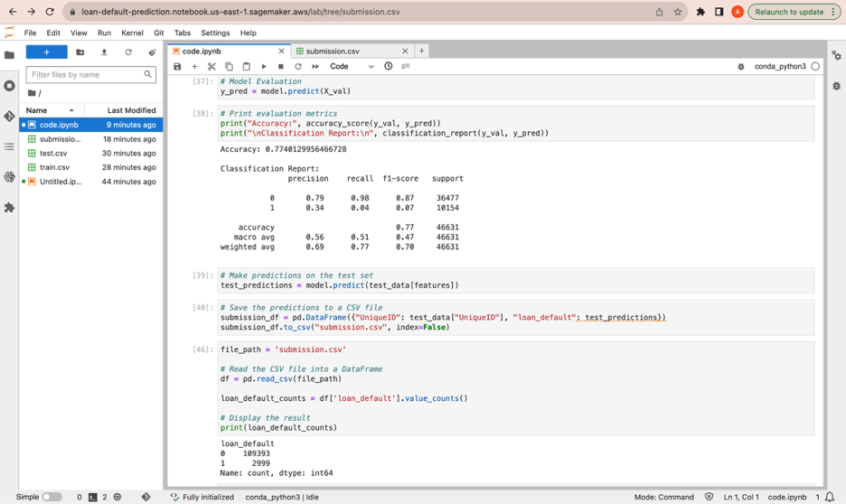
Data Analysis - Evaluation matrix of the dataset.

Slide 11
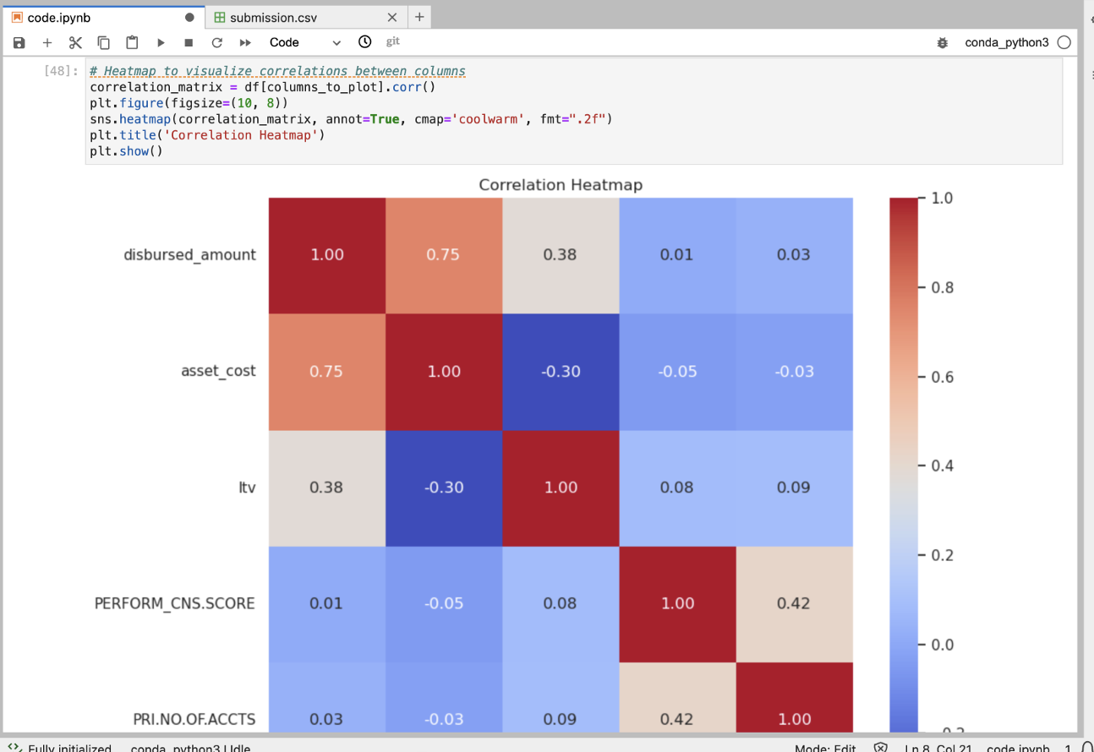
Data Analysis - Heatmap

Slide 12
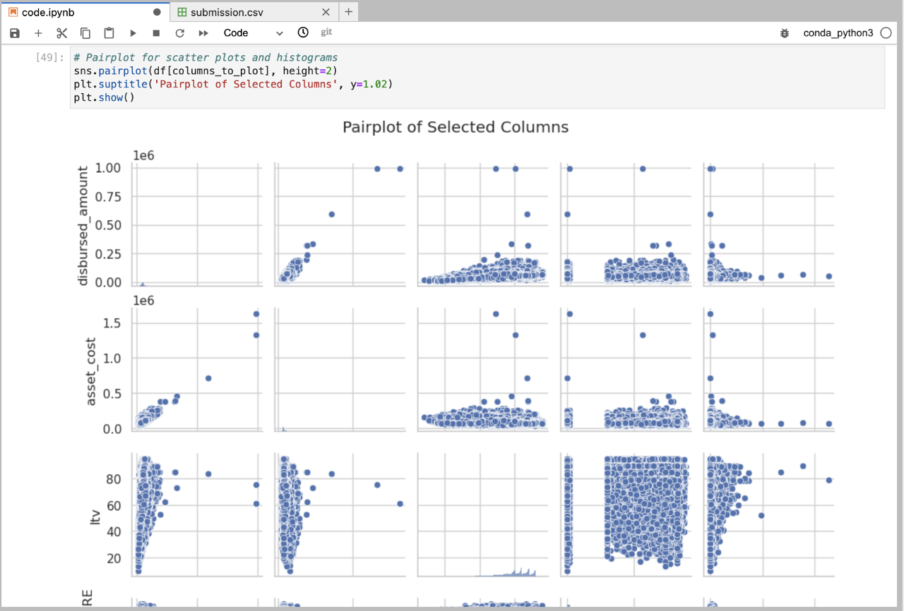
Data Analysis - scatter plot

Slide 13
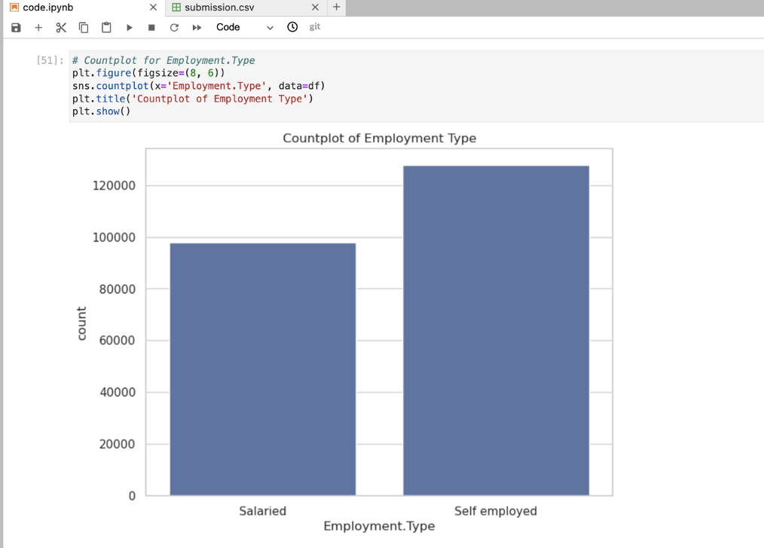
Data Analysis - Barchart

Slide 14
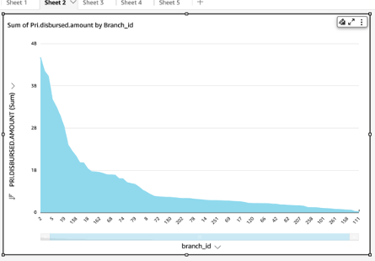
Visualization - LineChart

Slide 15
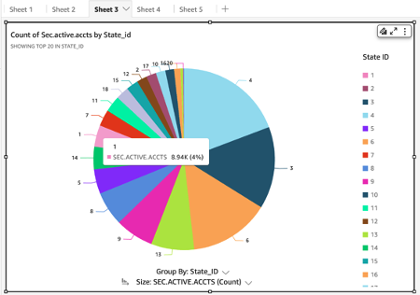
Visualization - Pie chart

Slide 16
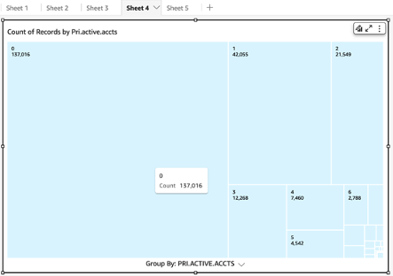
Visualization - Pie chart

Slide 17
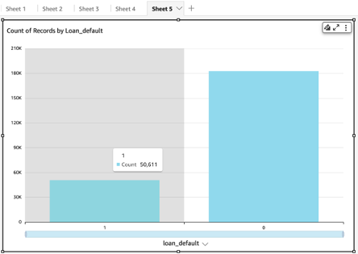
Visualization - Pie chart

Slide 18
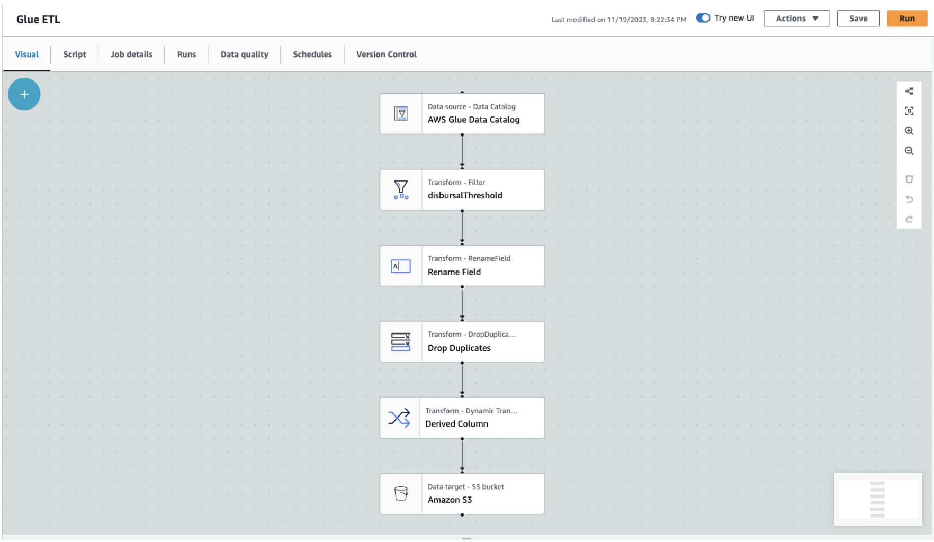
Visualization - Data Flow

Slide 19
Visualization - Data Flow
The visualization data flow begins with a data source, possibly external, which is cataloged using the AWS Glue Data Catalog, storing metadata for effective management. Following this, a filtering transformation is applied, specifically focusing on disbursal thresholds to retain records meeting defined criteria. The subsequent transformation involves renaming fields, a crucial step for standardizing or enhancing field names. The data then undergoes a process of dropping duplicate records to ensure integrity and eliminate redundancy. Another transformation step dynamically creates or derives new columns based on specific criteria, contributing to dataset enrichment. Finally, the processed data is directed to an Amazon S3 bucket, serving as the data target and storage location. This refined dataset is now ready for further analysis or visualization. The entire flow emphasizes data cleaning, standardization, and enrichment through systematic transformations. The integration of AWS Glue, S3, and visualization tools ensures a streamlined and effective data pipeline.

Slide 20
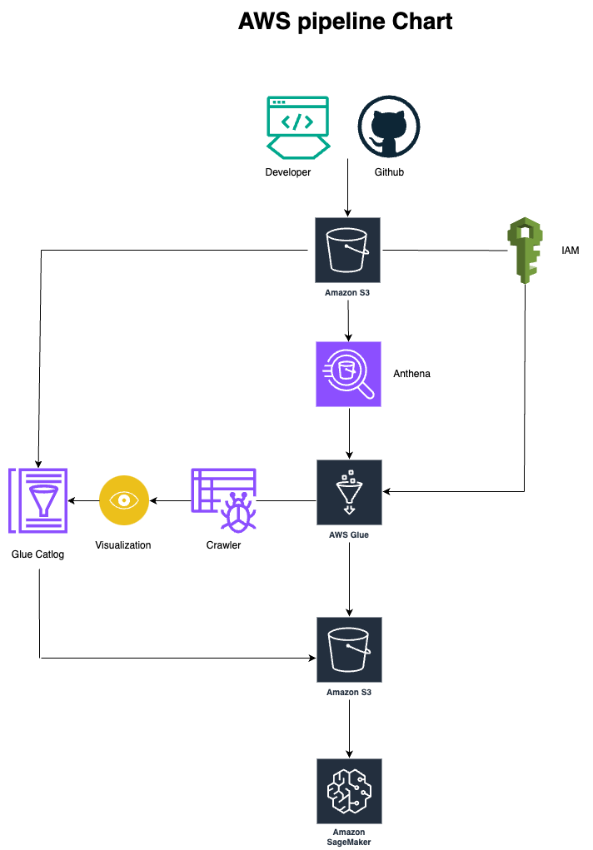

Slide 21
AWS pipeline chart - Description
AWS pipeline incorporates various services to facilitate a comprehensive data processing and analysis workflow. It starts with a developer using GitHub, indicating version-controlled storage of code and project artifacts in an Amazon S3 bucket. This S3 bucket is linked to AWS Glue Catalog for metadata management and IAM for secure access control. Additionally, the same S3 bucket is connected to Amazon Athena, enabling SQL queries for direct data analysis.
The connection between Athena and AWS Glue suggests optimization and transformation tasks by Glue for Athena queries. IAM is linked to AWS Glue, underscoring the importance of secure access control. AWS Glue is connected to a Crawler for data discovery and cataloging, and the output from the Glue Crawler is directed to a Visualization component, possibly using Amazon QuickSight. The Visualization output is linked back to the Glue Catalog for cataloging visualized data.
Moreover, the Glue Catalog is connected to another S3 bucket, indicating storage or backup of metadata. Another connection between AWS Glue and a different S3 bucket suggests Glue's involvement in data processing tasks. Finally, the original Amazon S3 bucket is connected to Amazon SageMaker, implying storage or retrieval of machine learning models or processed data. Overall, this pipeline streamlines code versioning, data storage, cataloging, transformation, and visualization in the AWS environment.

Slide 22
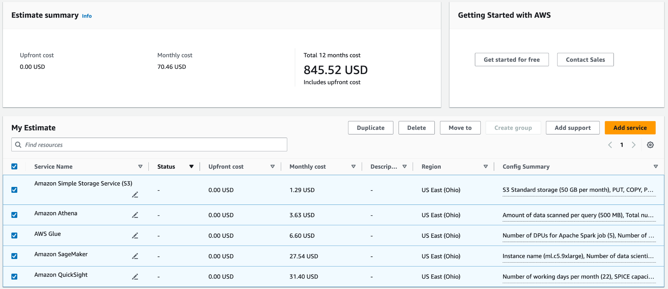
AWS Cost Estimation Breakdown for Services

Slide 23
AWS Cost Optimization
1. Resource Right-Sizing: Review the usage patterns of each resource ( Glue Jobs, Athena queries) and scale them to match actual needs.
2. Lifecycle Policies: Implement lifecycle policies for S3 to transition older data to cheaper storage classes or expire unnecessary data.
3. Query Optimization: Optimize Athena queries to reduce the amount of data scanned. Partitioning tables based on query patterns can significantly reduce costs.
4. Monitoring and Alerts: Set up monitoring and alerts using AWS CloudWatch to be notified about unusual spikes in resource usage
5. Reserved Instances or Savings Plans: Consider purchasing Reserved Instances or Savings Plans for predictable workloads to reduce costs
6. Review and Cleanup: Regularly review and clean up unused resources, old data, or redundant processes.

Slide 24
Conclusion
In conclusion, our Vehicle Loan Default Prediction project has successfully leveraged machine learning tools to develop a robust model for assessing the risk of default among loan applicants. The model, based on historical data and relevant features, exhibits accurate performance. This predictive tool is poised to enhance our loan approval processes, providing valuable insights into potential defaults. It's important to emphasize the model's role as a decision-support tool, meant to complement human judgment and existing risk assessment practices. Regular monitoring and updates will ensure its continued effectiveness in dynamic financial landscapes.

